Slide 1
Ledger Project
Revised: January 22th 2019

Slide 2
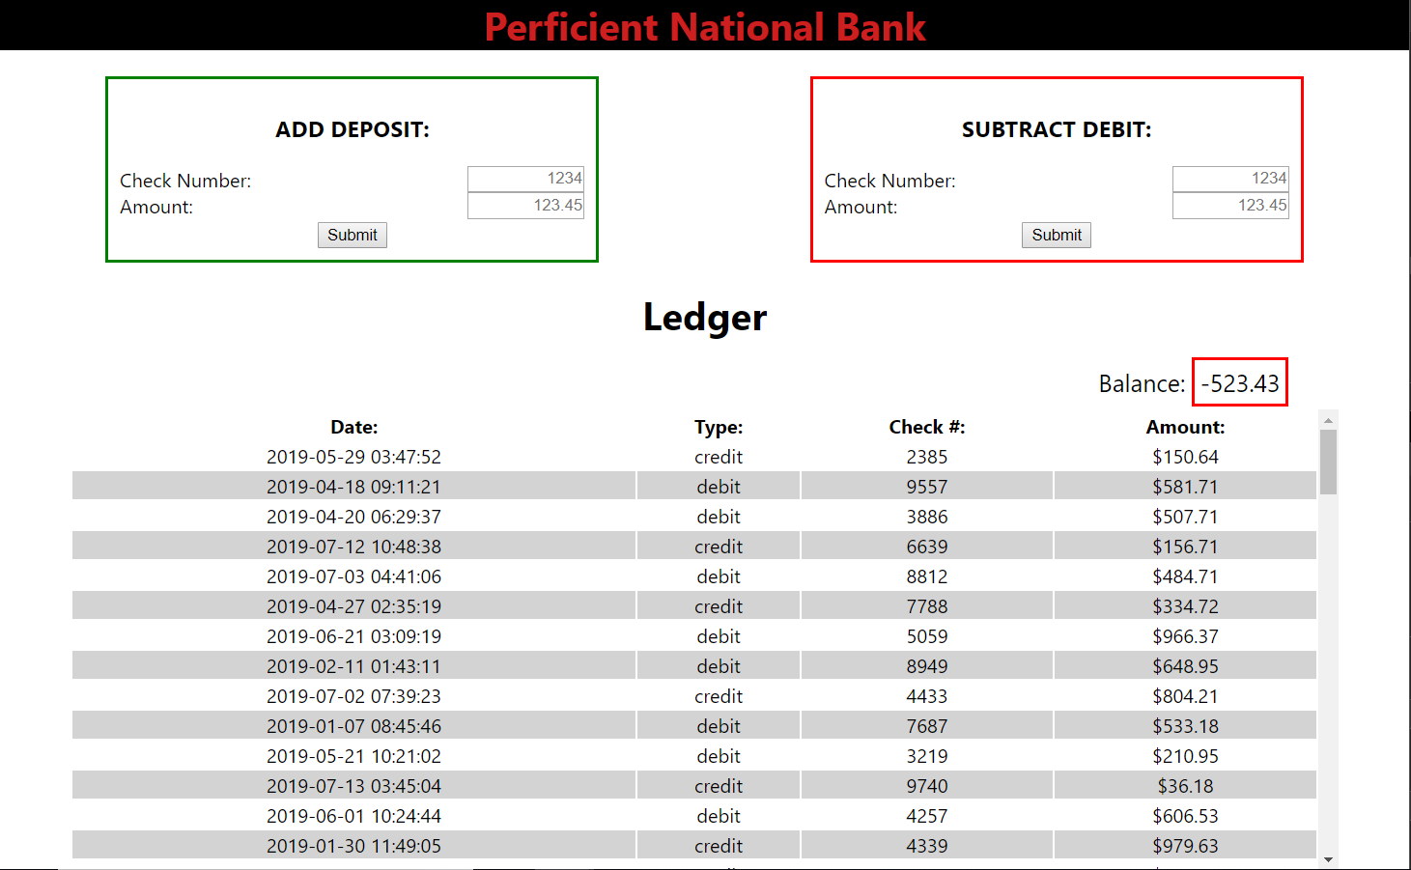
Make this:

Slide 3
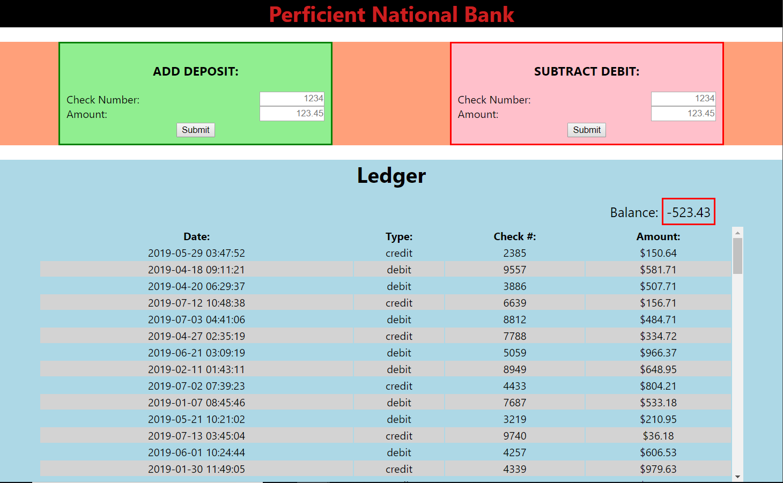
Component Strategy (just a suggestion!)

